Slide 1
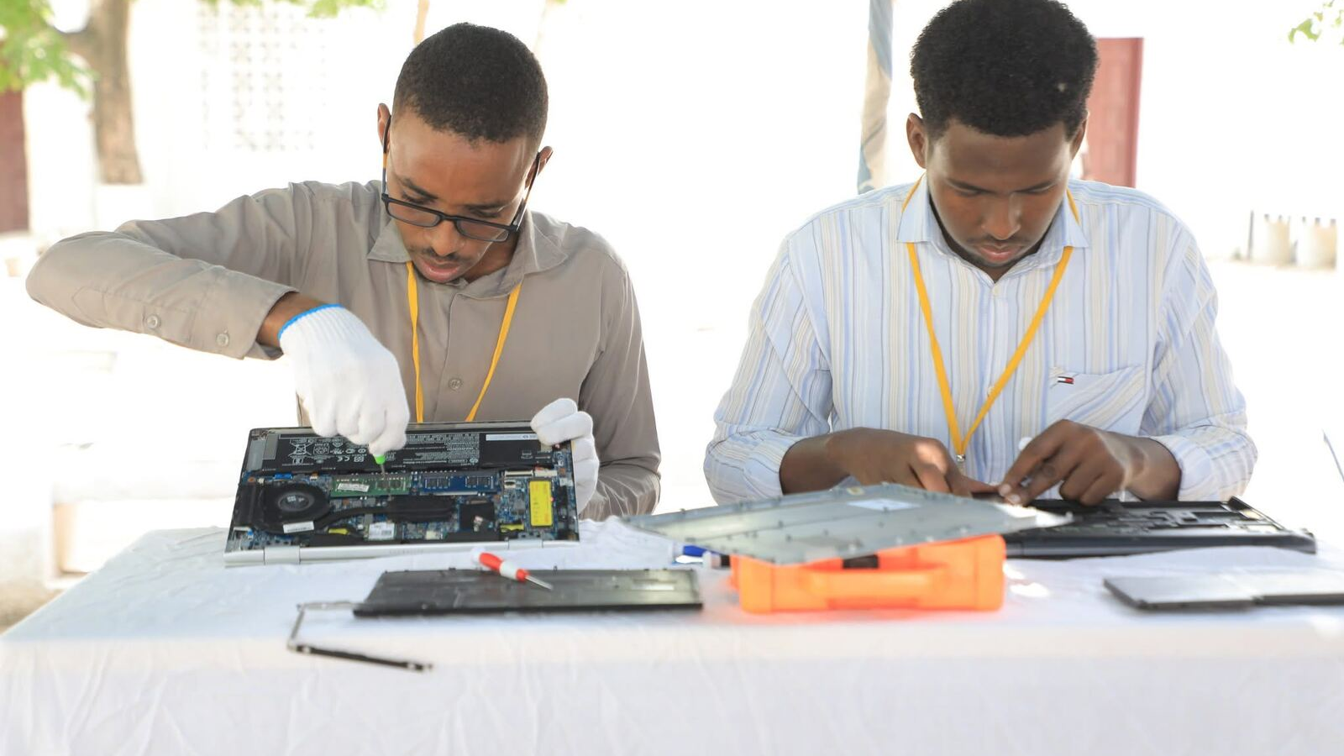
SIMADRepair
FACULTY OF COMPUTING · LEADERSHIP BRIEFING
The IT service desk behind the Computer Maintenance Program
SIMAD University · October 2026
Notes:
Introduce the platform: SIMADRepair is the system the Faculty of Computing built to run the Computer Maintenance Program, from online registration to handing every laptop back. The photo is from a previous program on Main Campus.

Slide 2
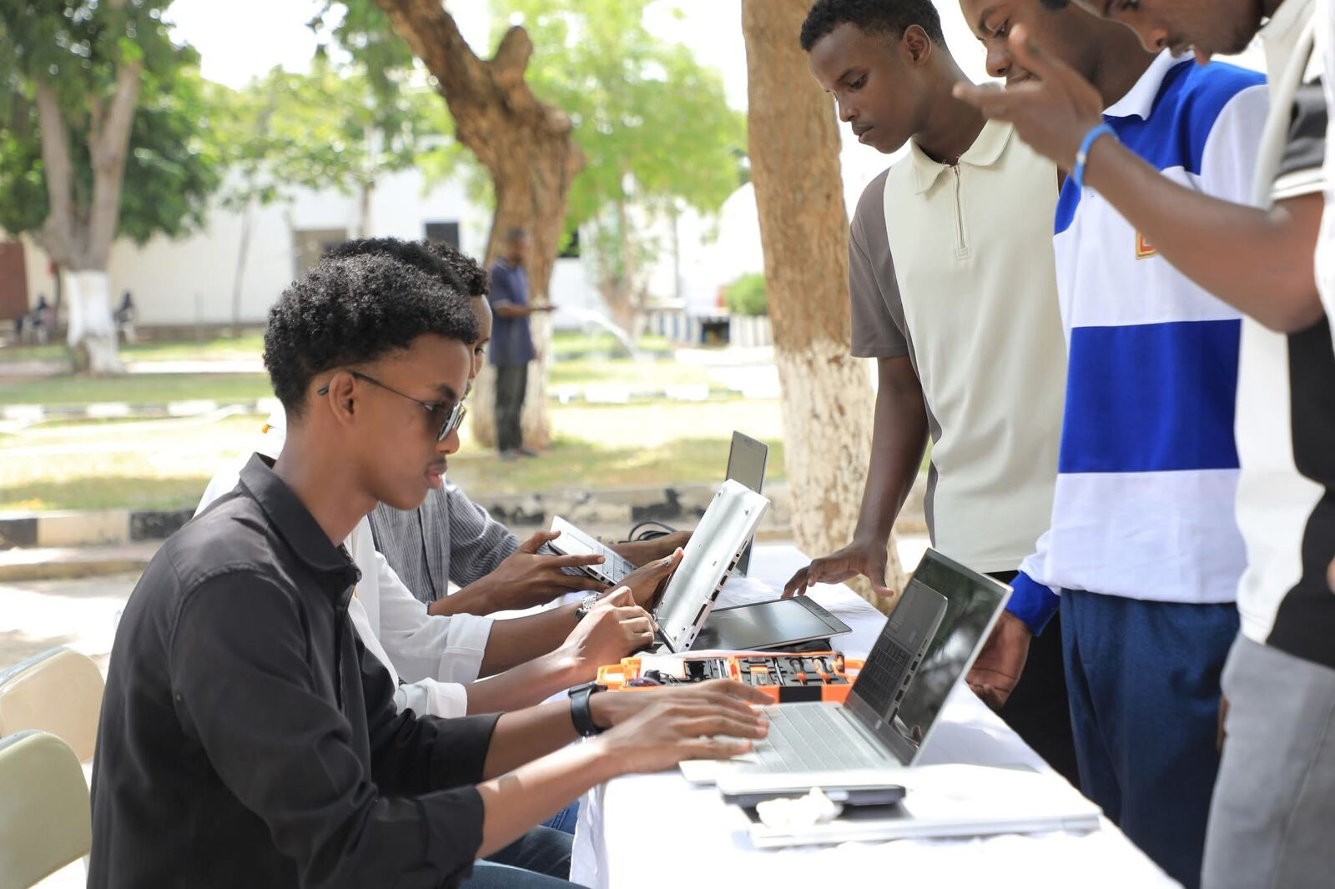
Computer Maintenance Program 2026
THE PROGRAM
27–28 October · Main Campus, SIMAD University
A free tune-up for every SIMAD student and staff laptop:
Hardware check and cleaning
Windows installation and software updates
Virus and malware scanning
Data backup assistance
Network connectivity testing
SIMADRepair · Faculty of Computing
02
Notes:
The program as it appears on the official poster: two days, Main Campus, five free services. Students fixing laptops for students. The platform exists to make these two days run smoothly and to show leadership exactly what was delivered.

Slide 3
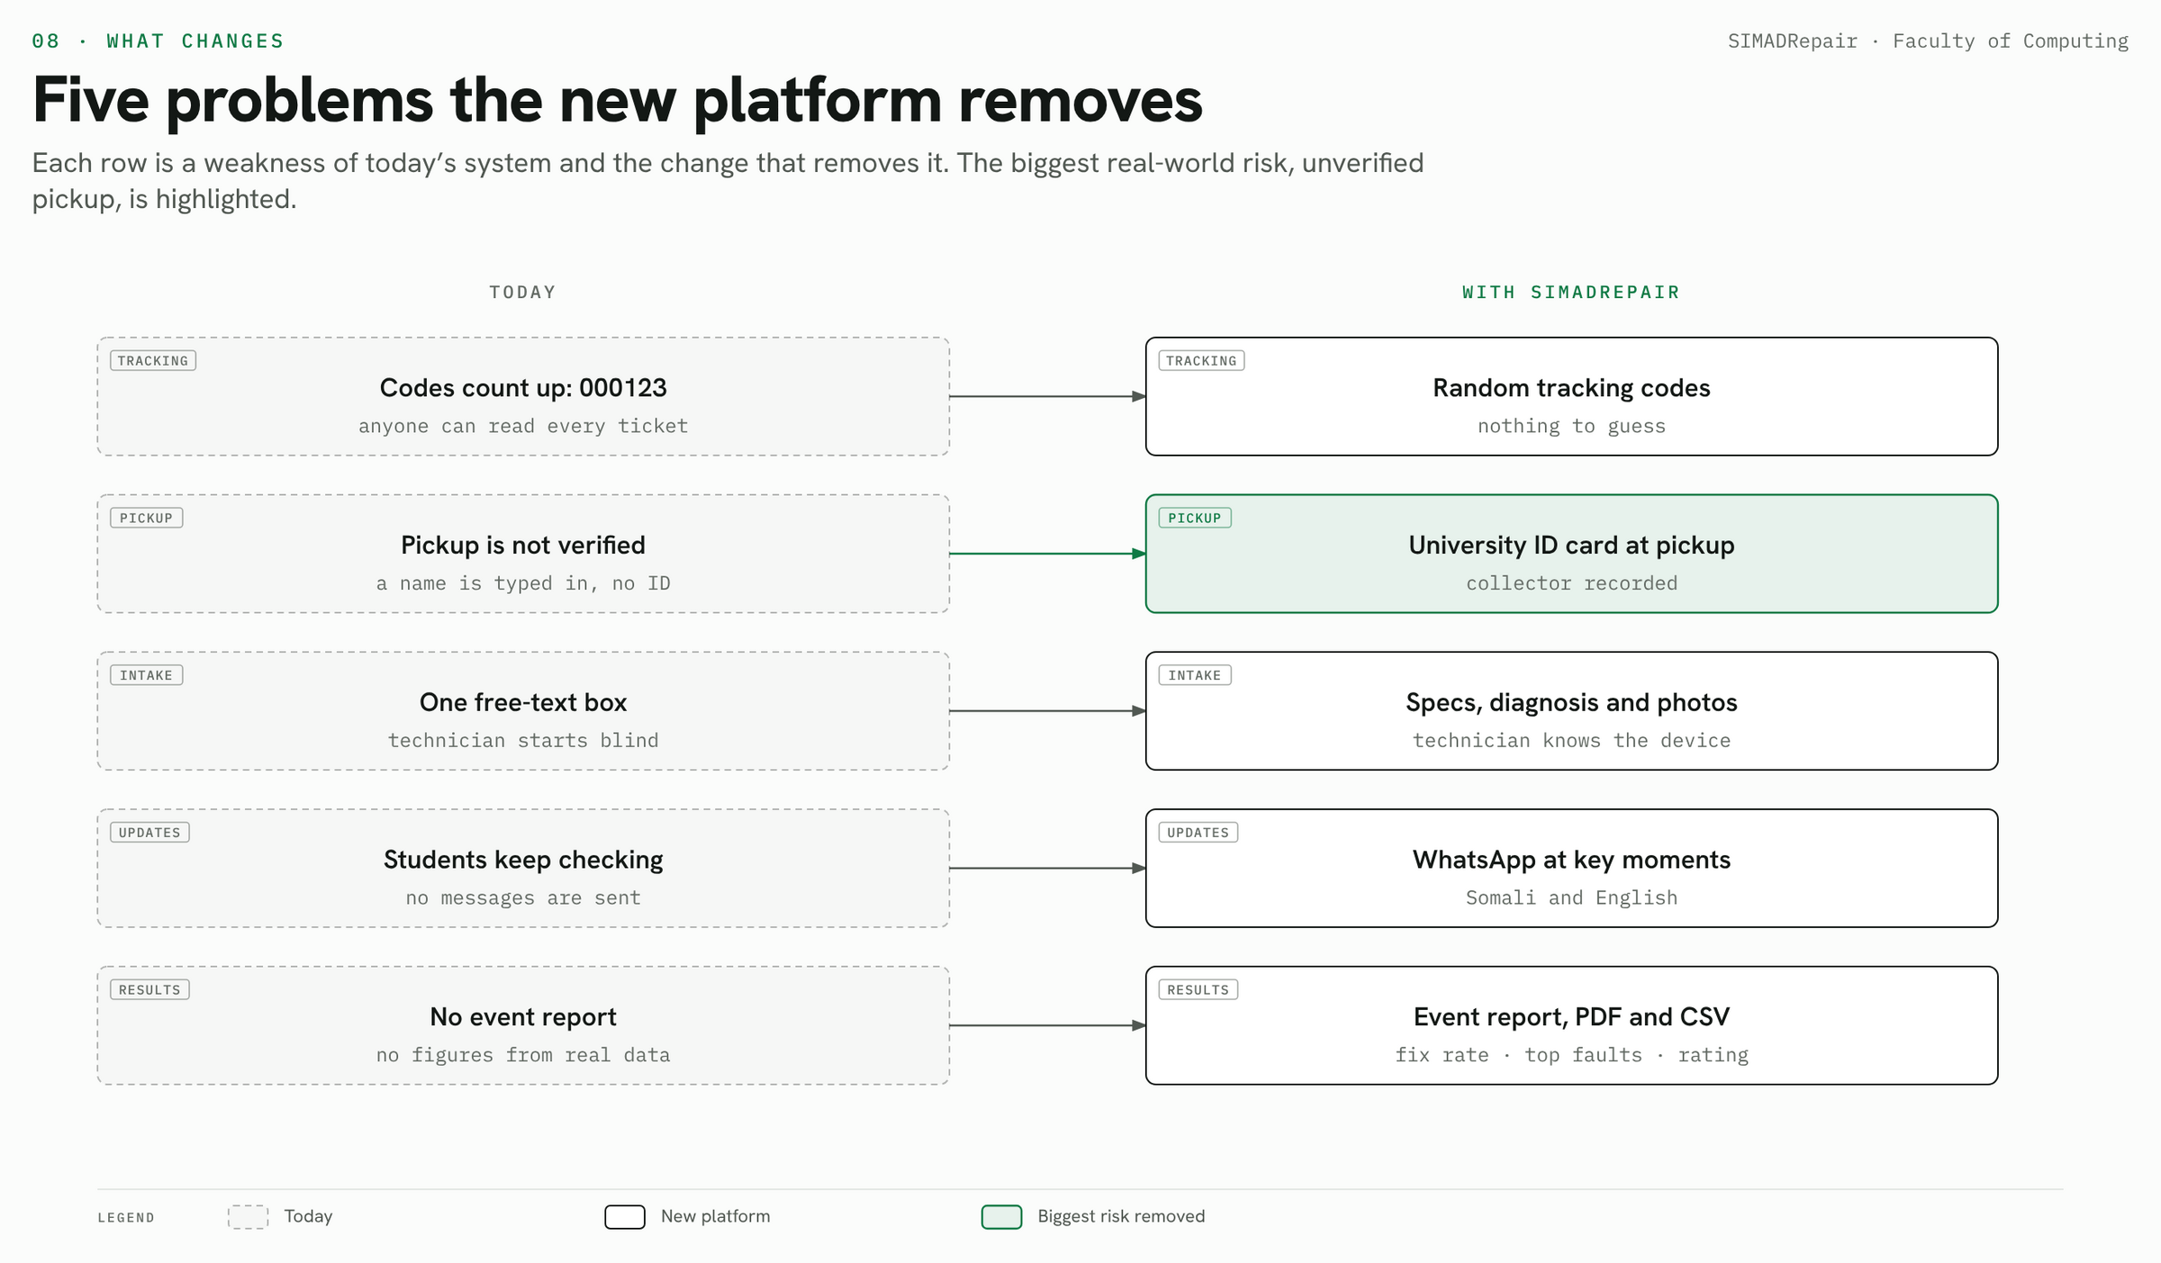
SIMADRepair · Faculty of Computing
03
Notes:
Start with why. The old system had sequential codes anyone could guess, pickup without checking ID, one free-text box for the problem, no updates for students and no report. Each row shows the change. The highlighted row, pickup by university ID card, removes the biggest real-world risk: a laptop handed to the wrong person.

Slide 4
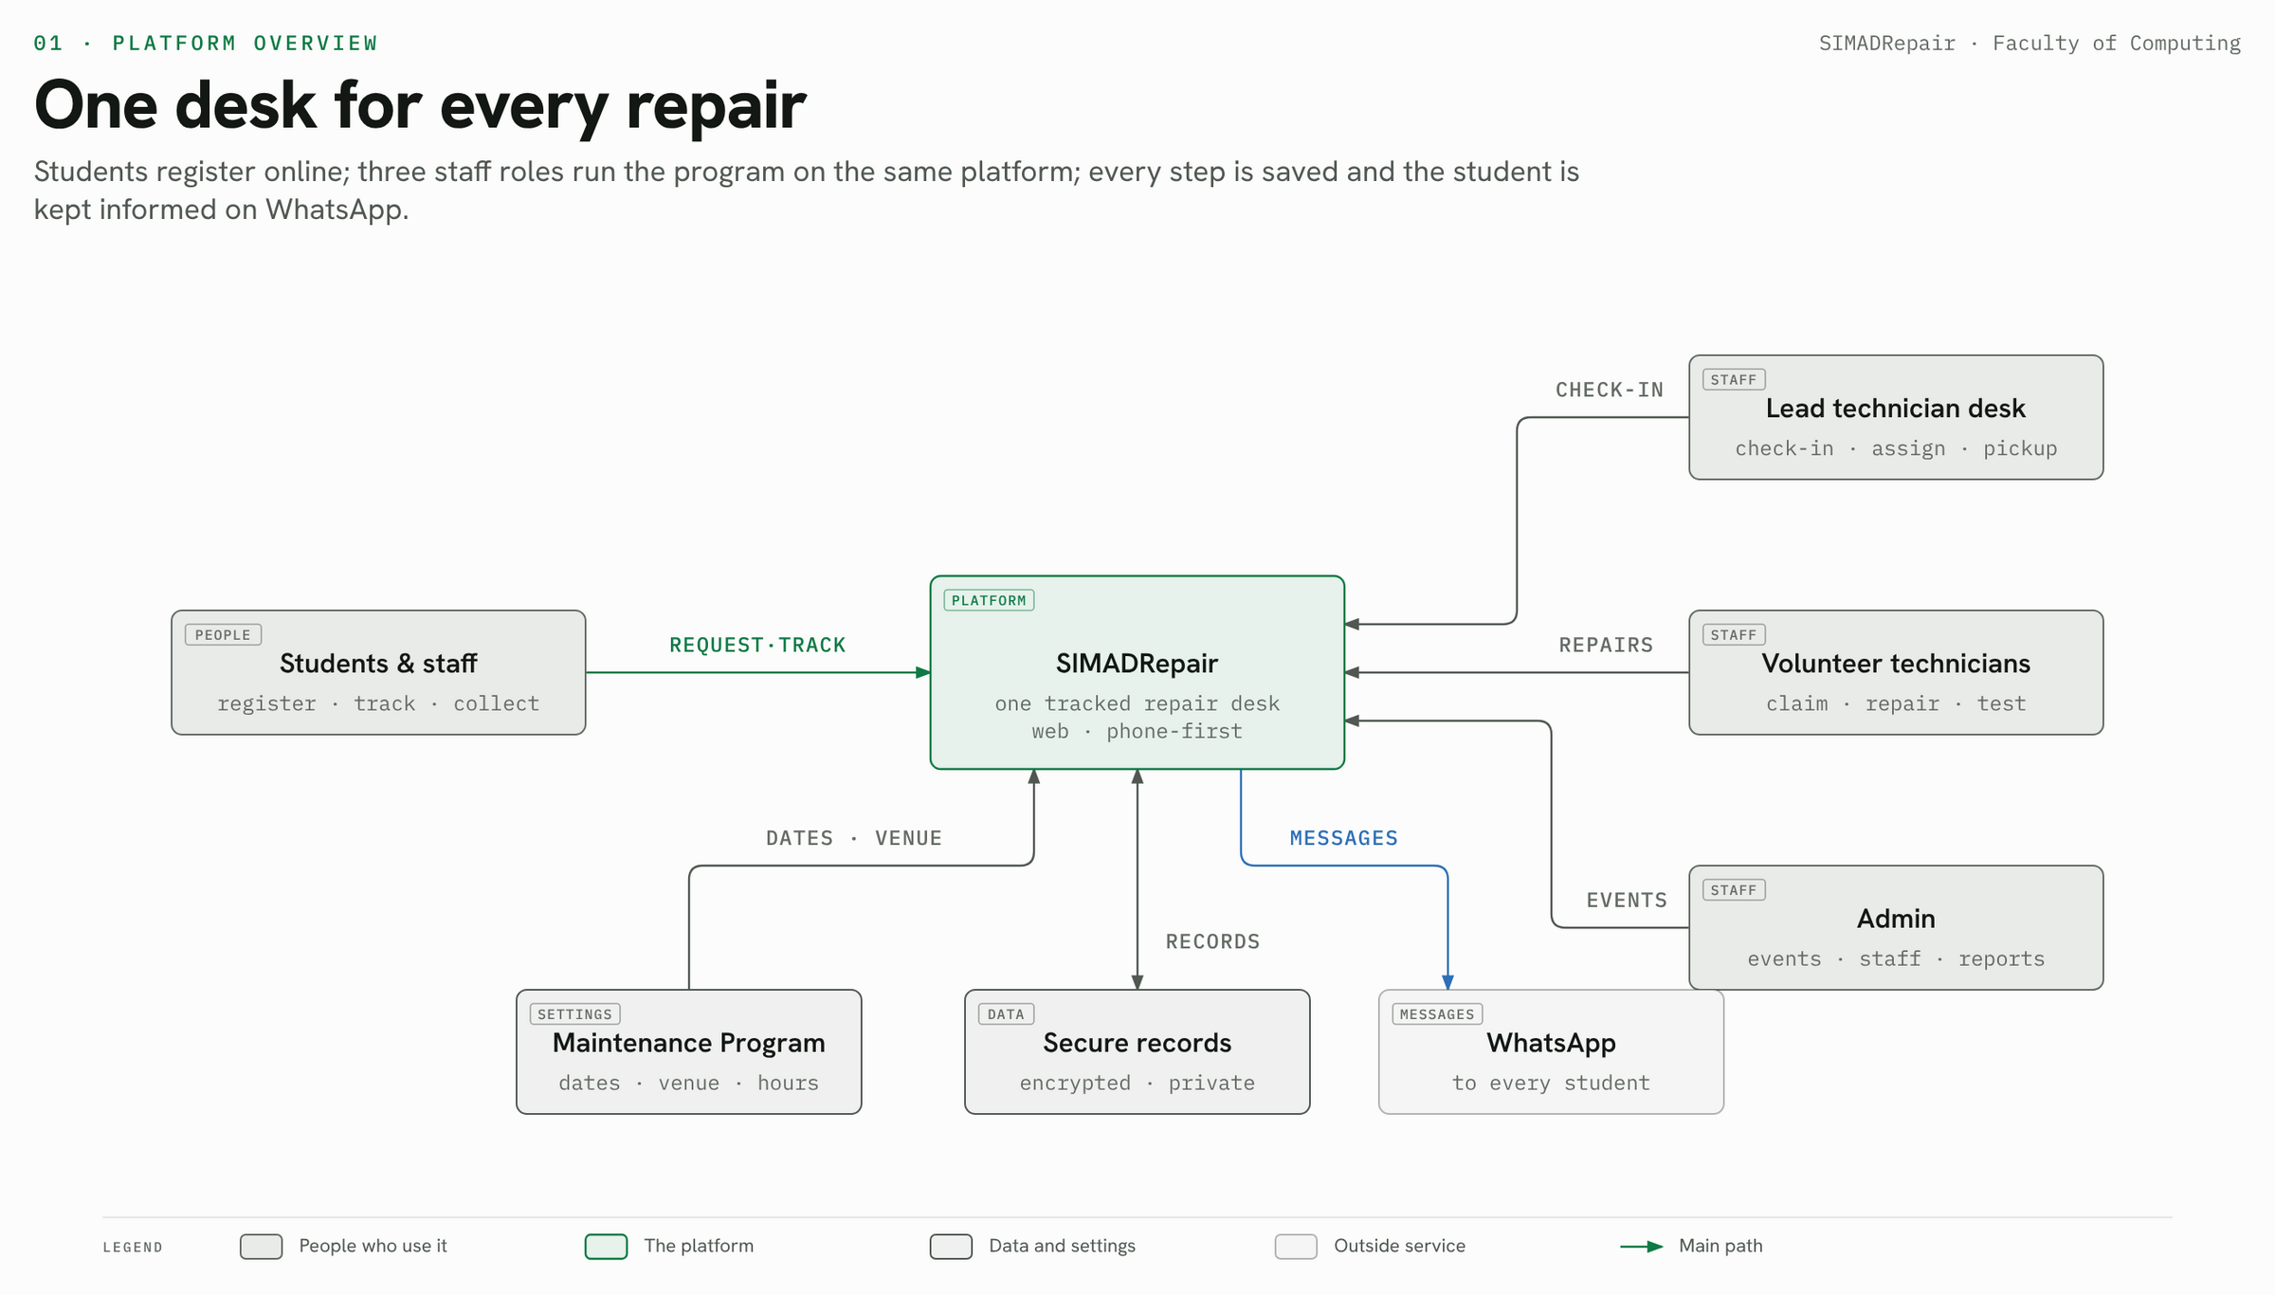
SIMADRepair · Faculty of Computing
04
Notes:
One platform for everyone. Students register and track without an account. Three staff roles — lead desk, volunteer technicians and admin — work on the same records. The program's settings (dates, venue, hours, desk WhatsApp) drive everything the public sees.

Slide 5
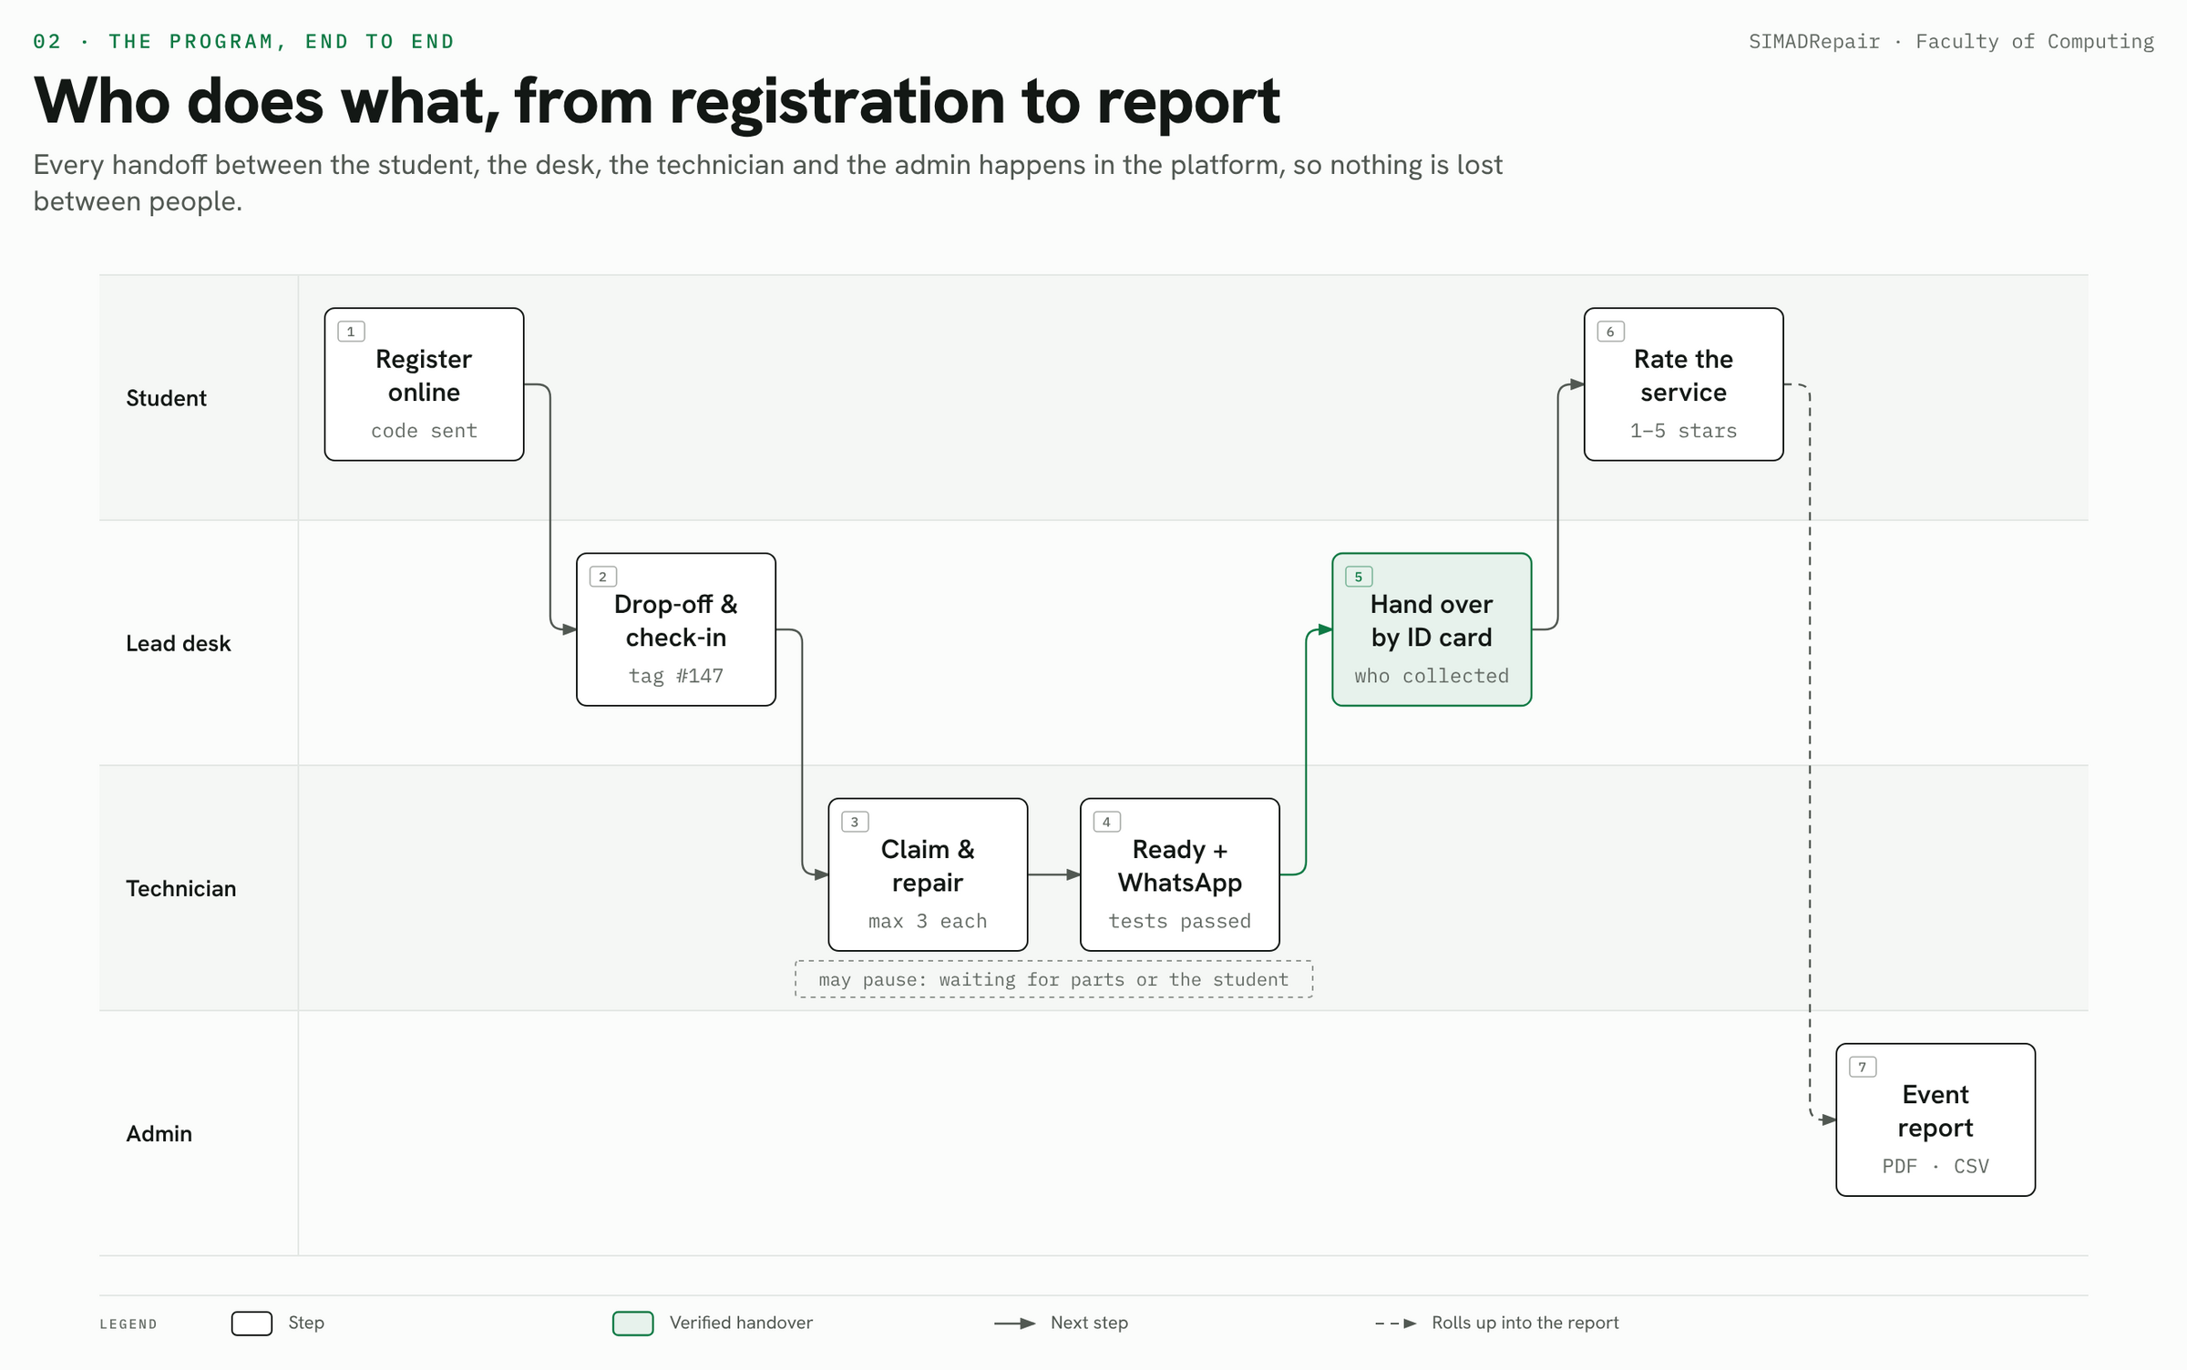
SIMADRepair · Faculty of Computing
05
Notes:
Walk the lanes left to right: register, drop-off and check-in with a tag number, claim and repair, ready with a WhatsApp message, hand-over against the ID card, rating. Everything rolls up into the event report for the admin. No handover happens outside the system.

Slide 6
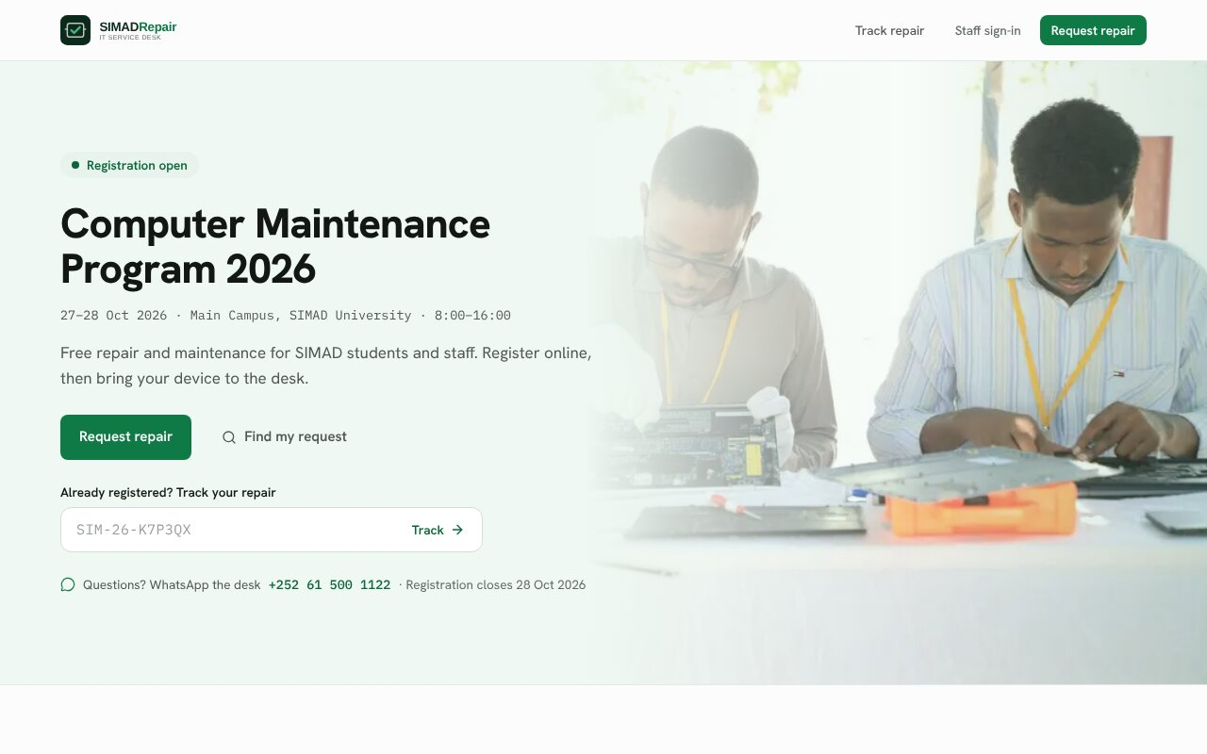
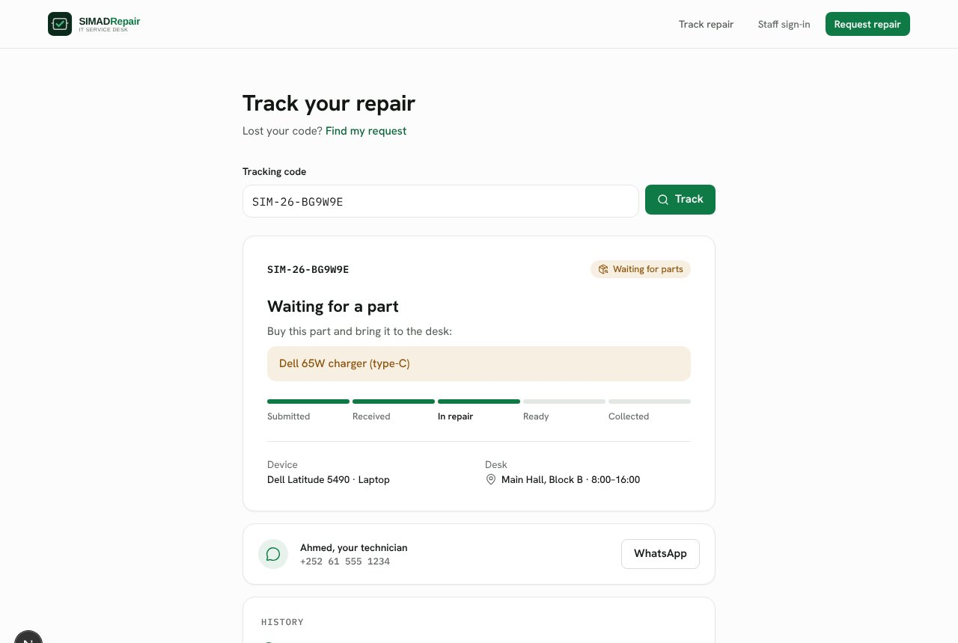
Register on the phone, follow every step
STUDENTS
Home: program dates, venue and one button to request a repair
Tracking: live status, what to bring, and the technician on WhatsApp
SIMADRepair · Faculty of Computing
06
Notes:
No account needed. A student fills a short form (university ID, WhatsApp number, device details, the problem with guided questions, up to 3 photos) and gets a tracking code. The tracking page shows the status in plain words, what to buy if a part is needed, and the technician's WhatsApp number.

Slide 7
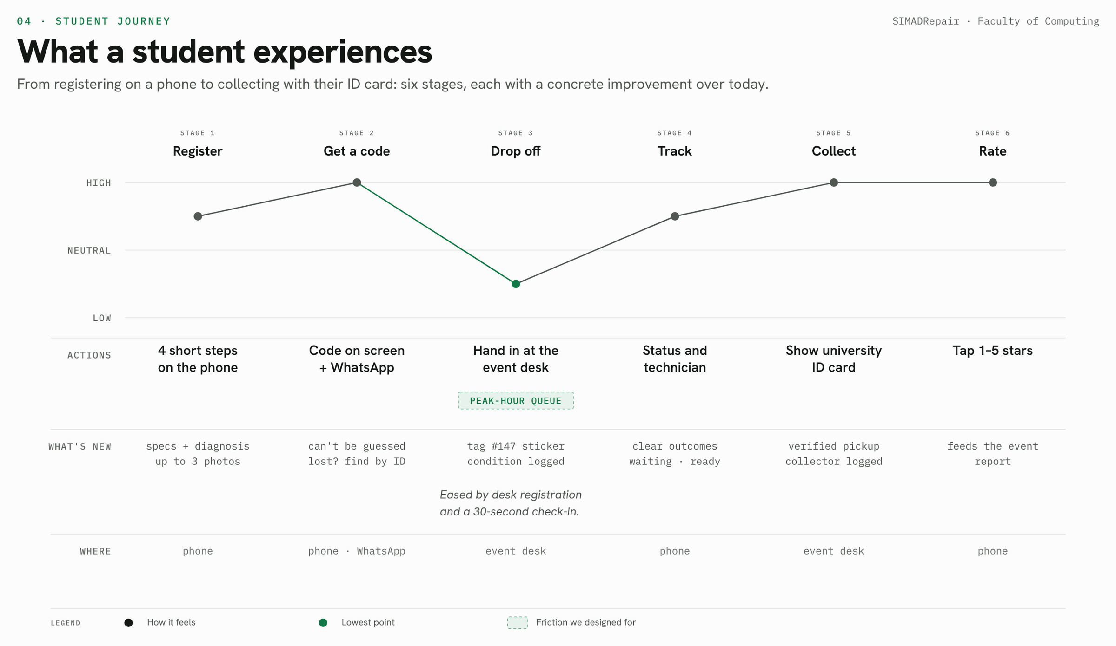
SIMADRepair · Faculty of Computing
07
Notes:
The low point for students is the queue at drop-off. We designed for it: desk registration for walk-ins and a check-in that takes about 30 seconds with a tag sticker. Lost your code? Find my request with your university ID.

Slide 8
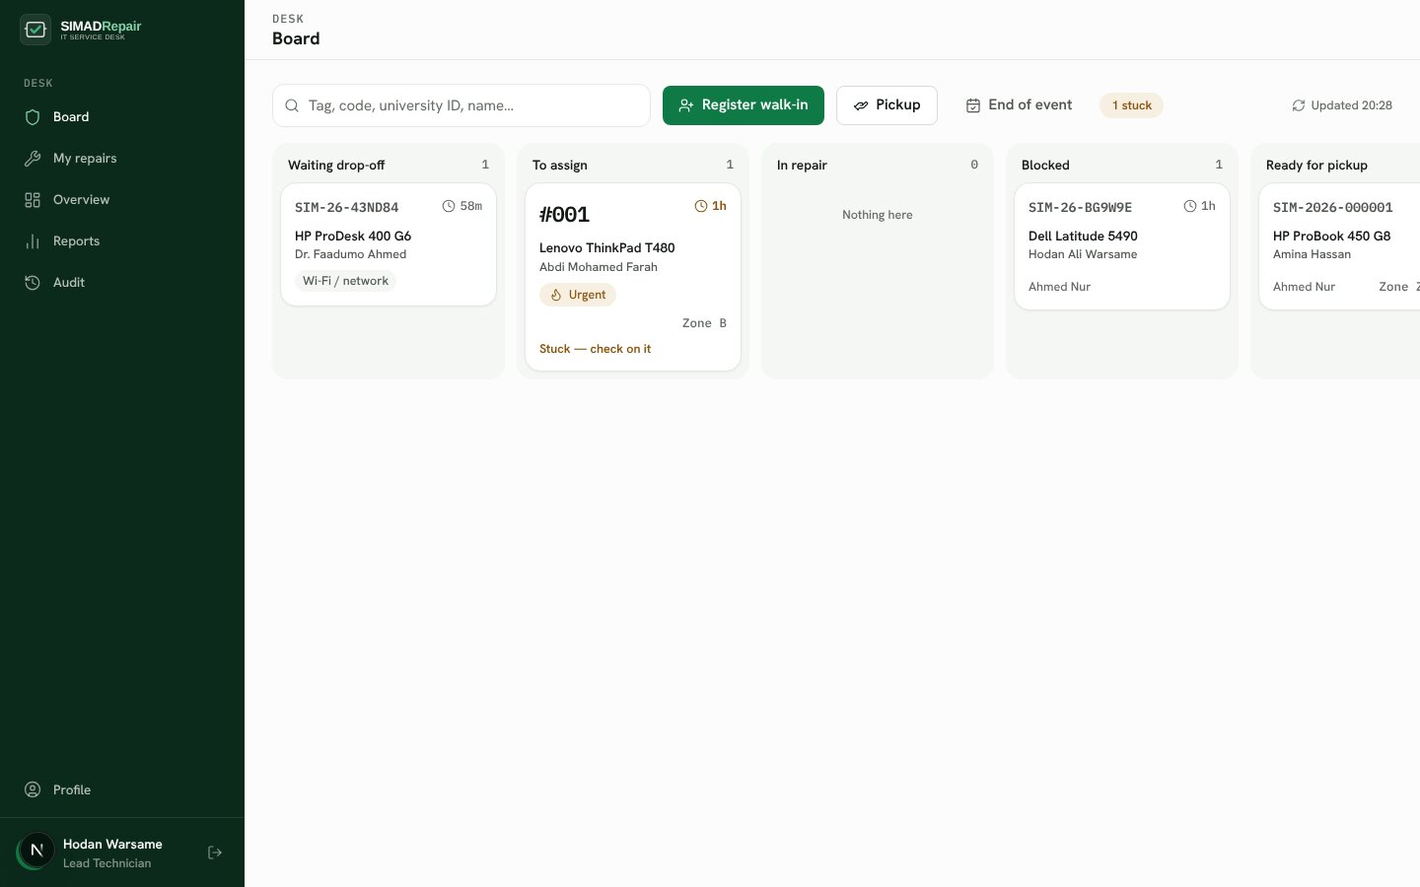
Every device on one live board
LEAD TECHNICIAN DESK
Check-in in ~30 seconds
ID card, condition, tag sticker #147
Assign by load and skill
Or volunteers claim up to 3 each
Stuck alerts
Unassigned over 1 hour turns red
Pickup by ID card
Collector name and phone recorded
SIMADRepair · Faculty of Computing
08
Notes:
The lead technician runs the desk from one board: waiting drop-off, to assign, in repair, blocked, ready for pickup and collected today. Walk-ins are registered at the desk. Every action can be undone with a reason, and at the end of the event uncollected devices move to the IT office in one step.

Slide 9
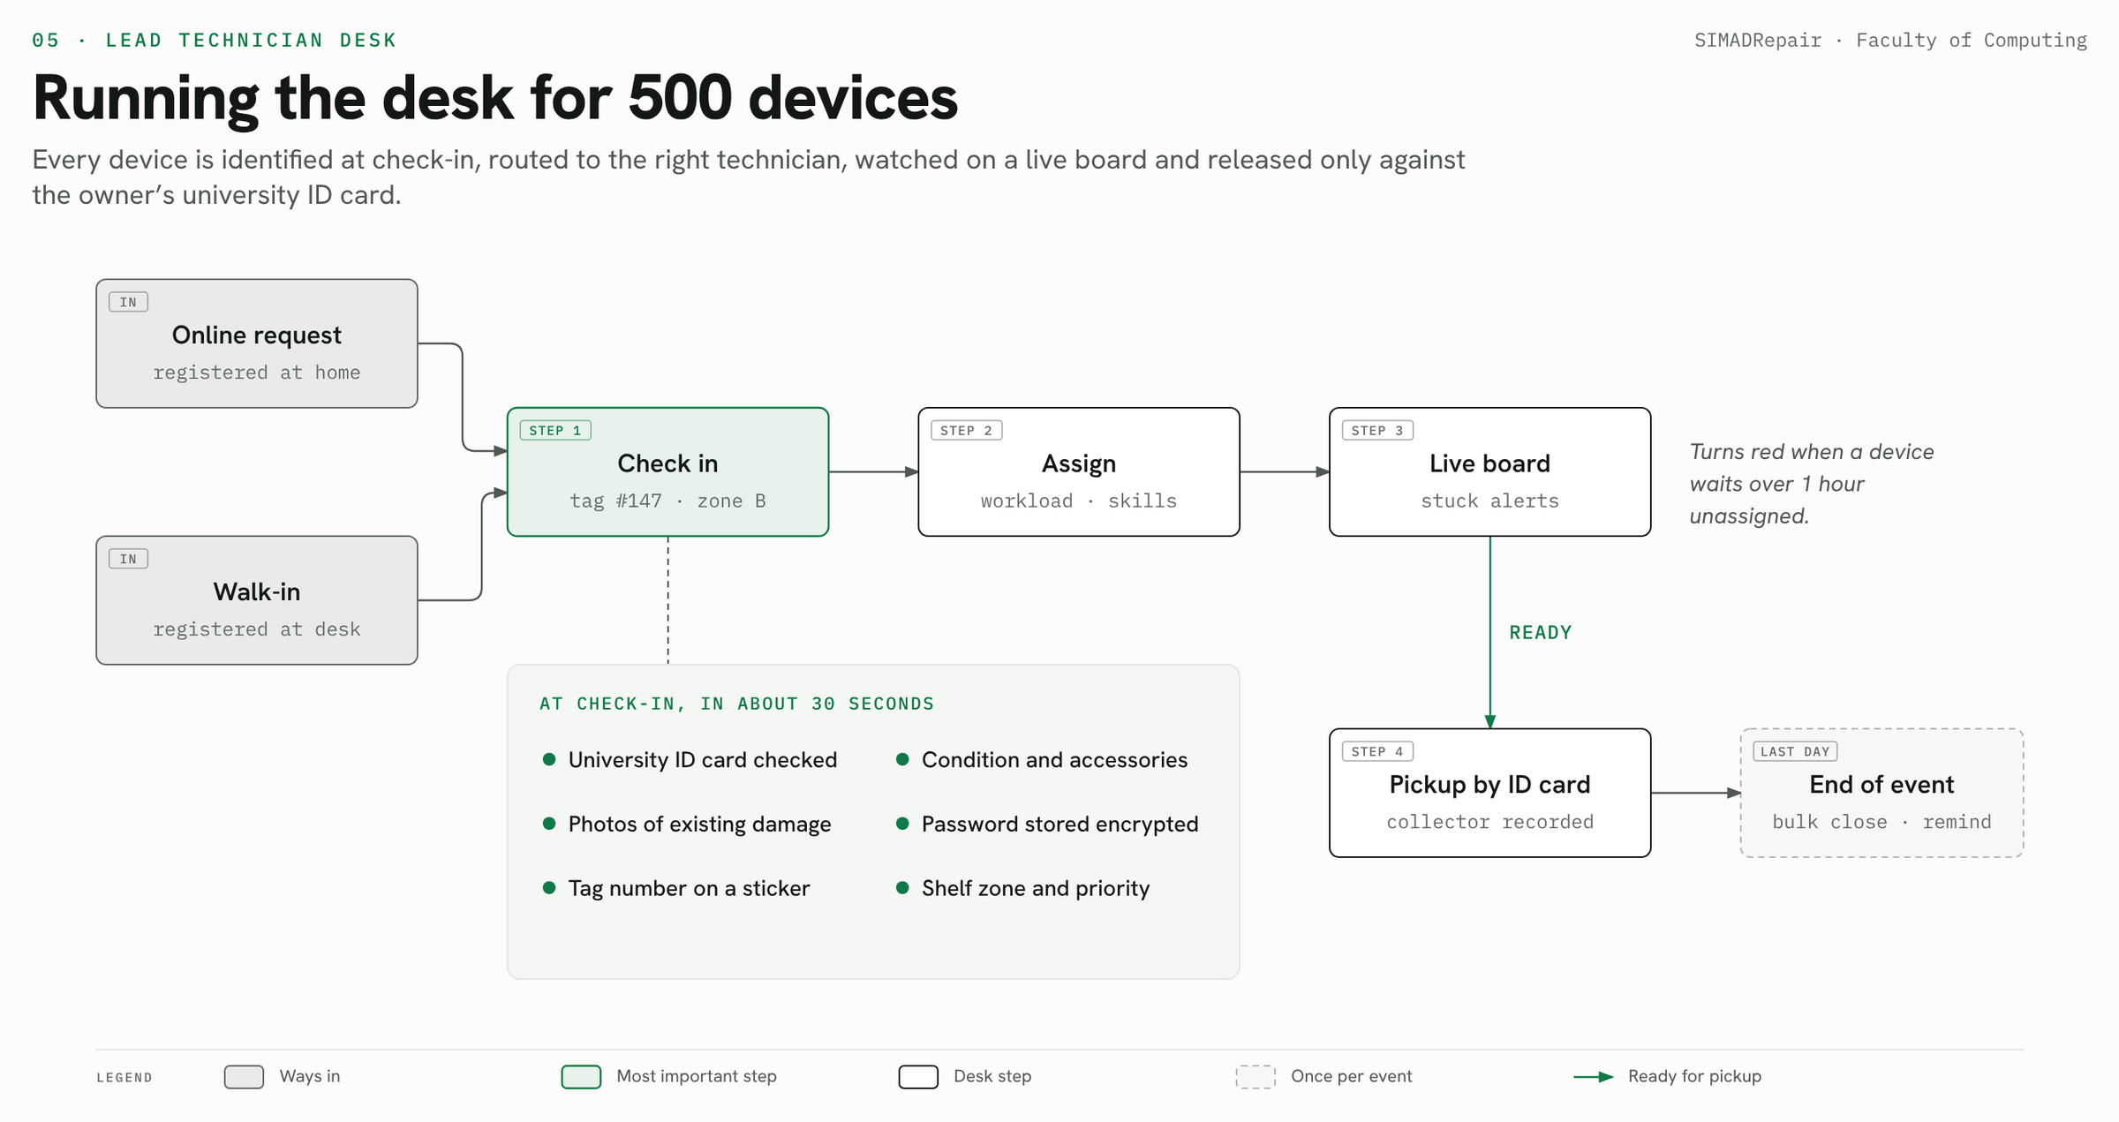
SIMADRepair · Faculty of Computing
09
Notes:
Check-in is the most important step: ID card checked, existing damage photographed, the device password stored encrypted, and a tag number written on a sticker. From there the device is never lost track of.

Slide 10
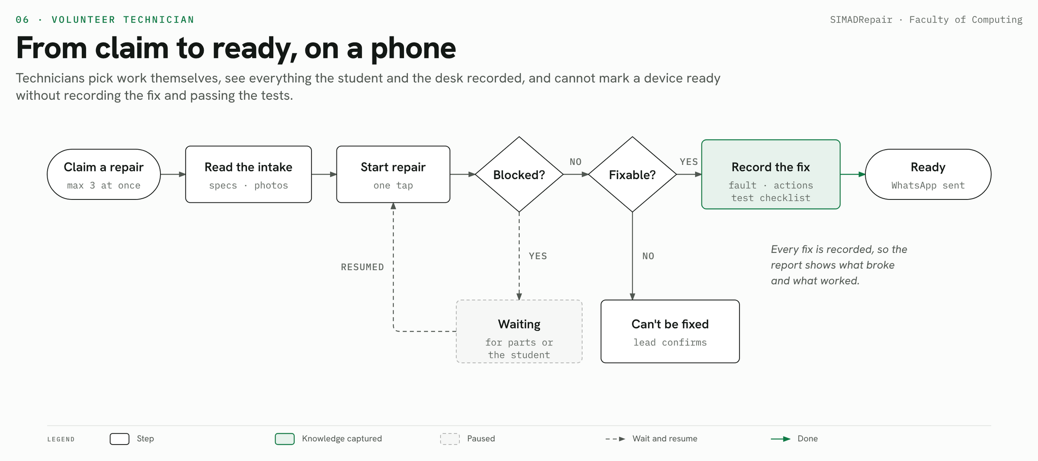
SIMADRepair · Faculty of Computing
10
Notes:
Volunteer technicians work from their phone. They see the device specs, the student's answers and photos before they start. A device cannot be marked ready without recording what was wrong, what was done, and passing the quick tests — so the report knows what was actually fixed.

Slide 11
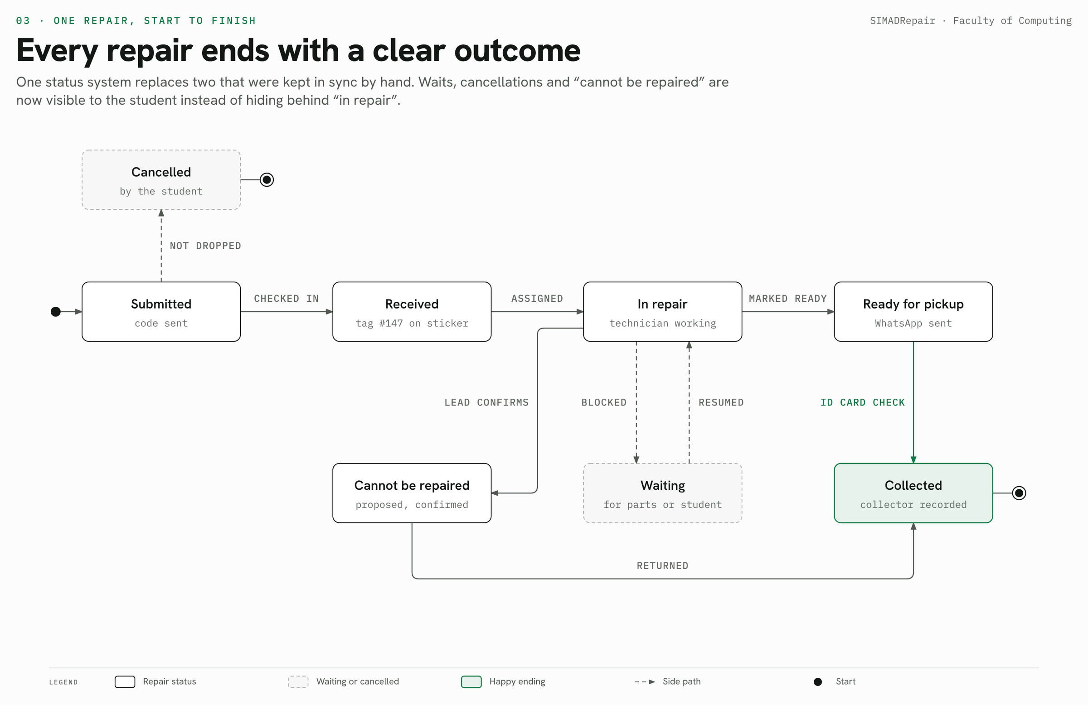
SIMADRepair · Faculty of Computing
11
Notes:
One status system for every repair. Waiting for a part, waiting for the student, cancelled and cannot be repaired are all visible to the student instead of hiding behind “in repair”. “Cannot be repaired” needs the lead to confirm, and every device ends collected.

Slide 12
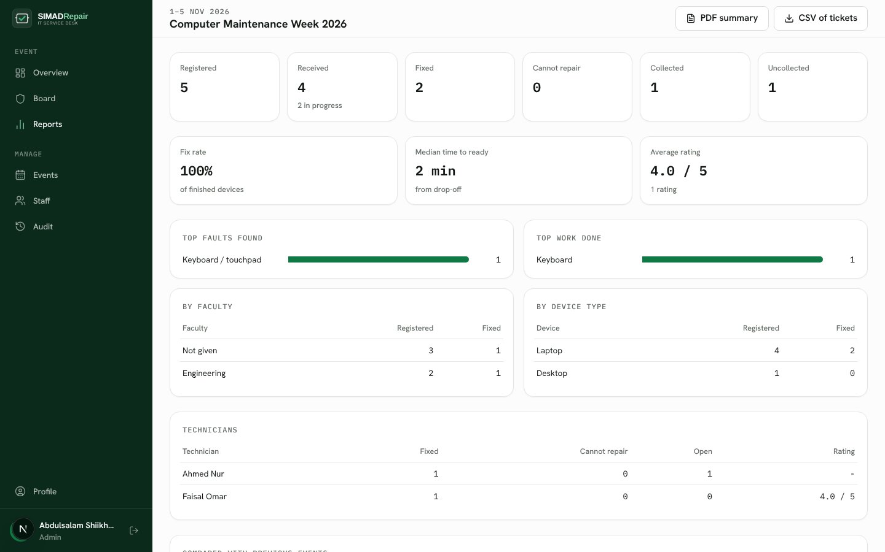
A report from real data after every event
ADMIN AND REPORTING
Live overview
Today’s numbers, stuck devices, technician load
Event report
Fix rate, top faults, by faculty, ratings
One-page PDF + CSV
For faculty heads and management
Audit search
Any ticket by code, tag or university ID
SIMADRepair · Faculty of Computing
12
Notes:
Every number in the report is computed from the tickets themselves — nothing is typed in by hand. The screenshot shows test data; the real report is produced after 27–28 October. The PDF fits one page and compares with previous programs once there are any.

Slide 13
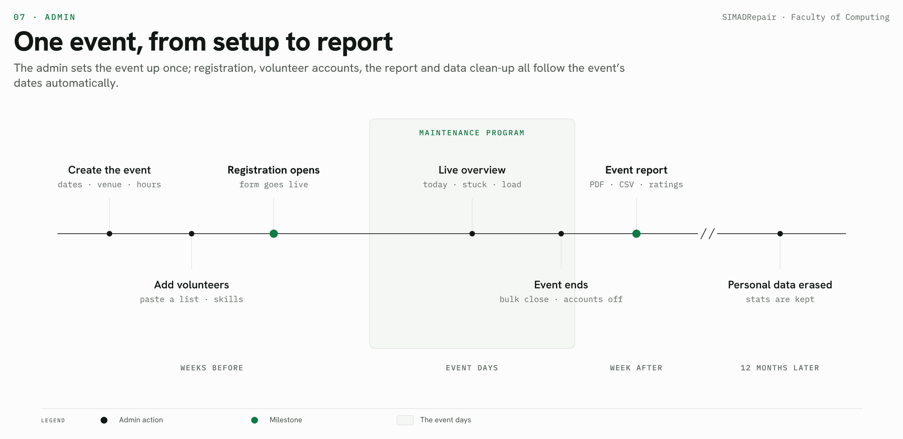
SIMADRepair · Faculty of Computing
13
Notes:
The admin sets the event up once: dates, venue, hours, desk WhatsApp and volunteers. Registration opens and closes by itself, volunteer accounts expire after the event, and personal data is erased automatically twelve months later.

Slide 14






Students’ devices and data stay protected
TRUST AND PRIVACY
Random tracking codes
Pickup by ID card
Passwords encrypted
Nothing to guess from someone else’s code
The desk checks the card and records who collected
Deleted at pickup or when the event ends
Full audit trail
Erased after 12 months
Access by role
Who did what, when and why, for every step
Personal details go; anonymous statistics stay
Volunteer access ends with the event
SIMADRepair · Faculty of Computing
14
Notes:
Students hand over laptops with their files and passwords, so trust matters. Photos are private and only staff can see them. Every step is logged with the person and their reason, and personal details are erased automatically twelve months after the event.

Slide 15
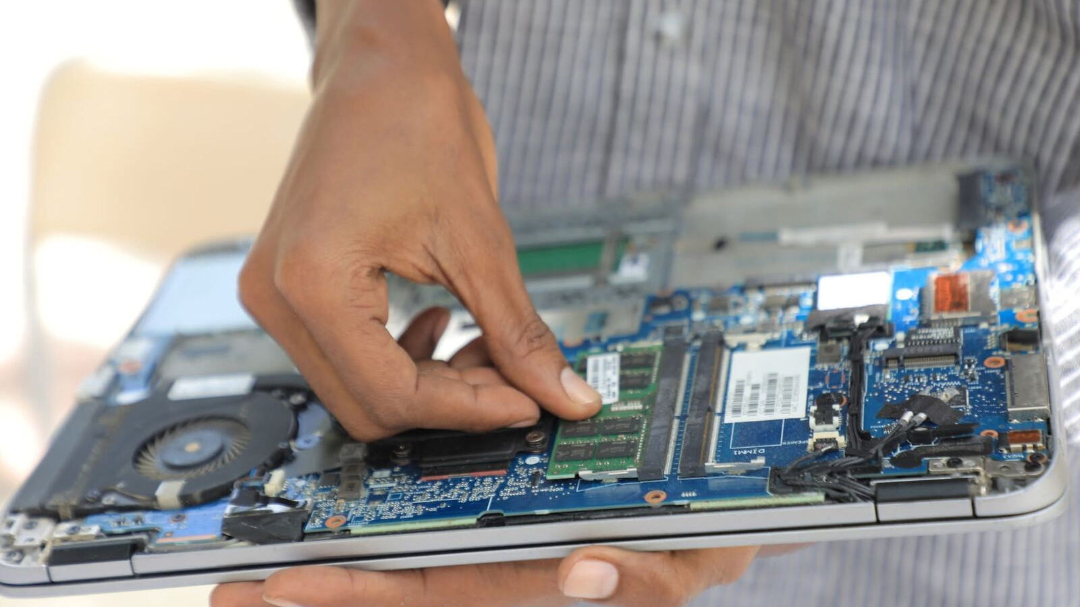
Every repair leaves a record: what was wrong, what we fixed and who took it home.
WHY IT MATTERS
Notes:
Pause here. This is the change in one sentence: from paper and memory to a record the university can trust and report on.

Slide 16






Ready for 27–28 October
READINESS
Built and tested
Before 27 October
Website, registration and tracking
Set the event: hours and desk WhatsApp
Desk board, check-in and pickup
Add the volunteer accounts
Technician workspace on the phone
Share the registration link with students
WhatsApp messages in Somali and English
Native-speaker check of Somali messages
Event report, PDF and CSV
Strong admin password on the live site
SIMADRepair · Faculty of Computing
16
Notes:
Everything on the left is built and tested end to end. The right column is setup, not development: a few settings, the volunteer list, and getting the link to students — for example through SIMAD’s social channels and a QR code next to the poster. Ask leadership for help sharing the link.

Slide 17
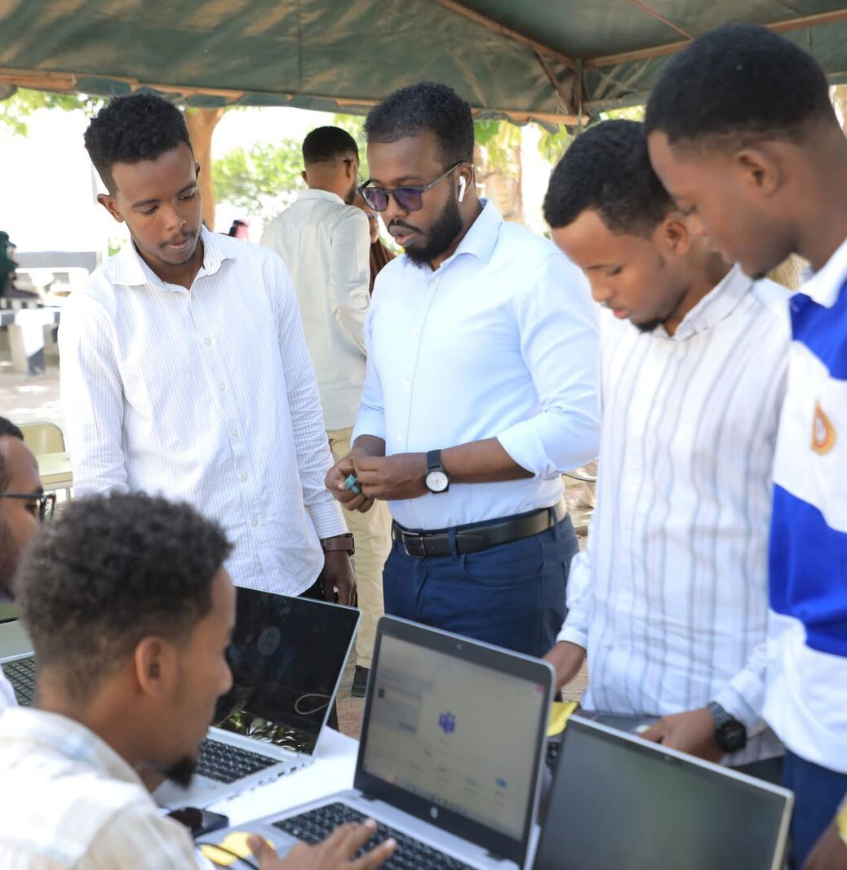
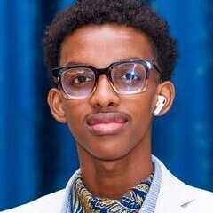
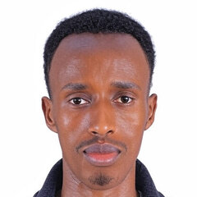

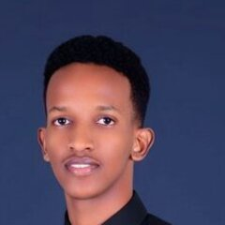
Faculty of Computing Engineering Team
BUILT BY
Eng. Muscab Abdirashid
Eng. Ishak Abdiaziz
Full Stack Software Engineer
Team Lead Engineer
Eng. Ruweydo Hassan
Eng. Abdulsalam Hassan
Software Developer
Backend & AI Engineer
Delivered at the desk by Faculty of Computing student volunteers.
SIMADRepair · Faculty of Computing
17
Notes:
Introduce the four engineers who built the platform, and thank the student volunteers who run the desk and do the repairs during the program.

Slide 18
Thank you
Questions and feedback are welcome.
[website link] · Computer Maintenance Program · 27–28 October
Notes:
Open the website live if there is time: show the home page, register a test request, and track it. Replace [website link] with the live address before presenting.

